Slide 1
Monitoring Population to find Schools with low Student Retention
Stetson Zirkelbach

Slide 2
Events surrounding this data
Changes in schools takes time and it takes time to see a return on any investment made in schools. The results of those changes can take a while to see. Forexample the data sets provided here are heavily influenced by the changes from the Obama administration outlaid here: https://www.ed.gov/k-12reforms
This analysis will also cut off largely before the effects of COVID are seen in the data sets since they are 5 year studies but that analysis will be fascinating and is already producing data in current studies like here https://www.pnas.org/content/118/17/e2022376118
Largely this project is concerned with finding these trends in the larger neighborhood population before launching more detailed studies

Slide 3
School Quality and Enrollment
School ratings for example from https://www.greatschools.org/ do not have a stor to track how they have changed over time
This makes it hard to even estimate how school ratings affect ted movement over time
Additionally, there are several places that rate schools and their methodologies are not compatible

Slide 4
Data Set
Neighborhood surveys
5 year averages
Breaks grades into 4 year blocks for reporting purposes
Used the 2006-2010, 2011-2015 and 2015-2019 surveys
Focused solely on enrollment numbers
Each neighborhood has a total enrollment and then it breaks that down into nursery school or pre-k, kindergarten, grades 1-4, grades 5-8, grades 9-12, College undergraduate student and graduate students
The data is anonymized so there are just counts per neighborhood

Slide 5
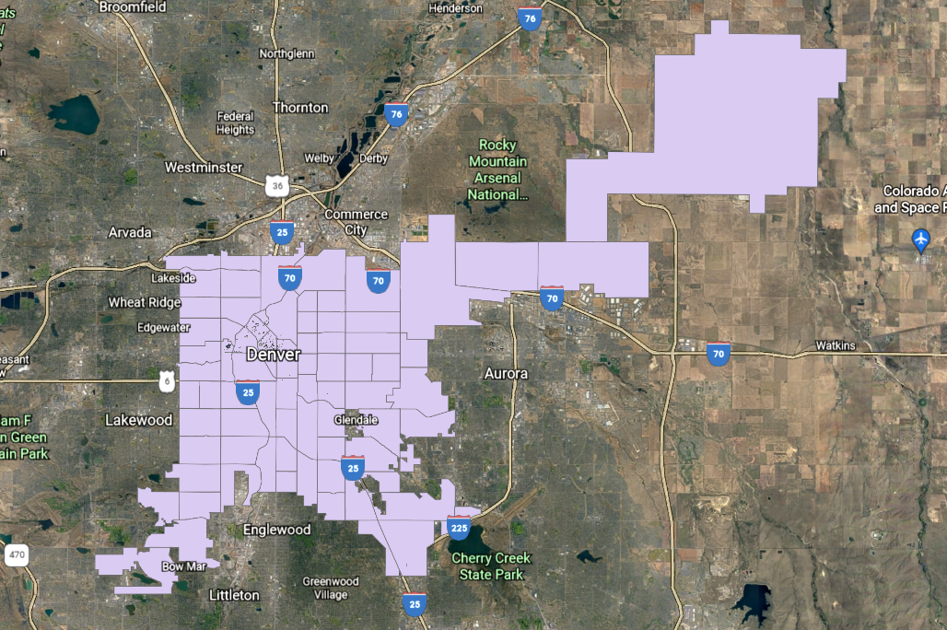

Slide 6
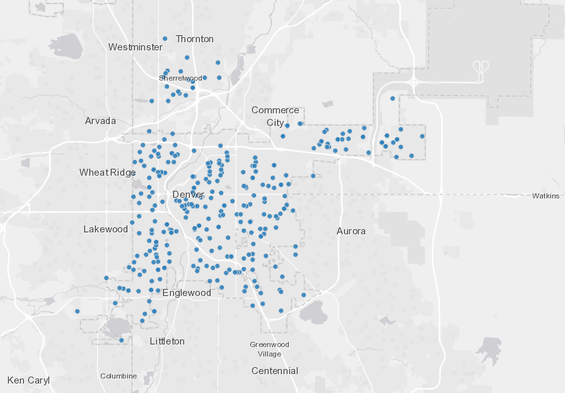

Slide 7
Challenges
The data is already anonymized so combining neighborhoods proved to not yield any useable results.
Only are counts recorded so number changes are not known if the person stayed in Denver or left the state
This method can only track broad trends, so more analysis needs to be done once trends are analized to obtain useful data.

Slide 8
Model Issues
The volume of nodes makes cycle enumeration difficult
Movement between neighborhoods is poorly defined and has a lot of factors making the already complex model more complex

Slide 9
Neighborhood Classifications
There is not enough time to go through every neighborhood and other student population statistics.
Classifying neighborhoods based on population is the goal and come from both aspects we are looking at, a neighborhood could have a very stable enrolled population, but is enrollment gains in one demographic are covering for losses in another.
The other thing will be how the neighborhood performs compared to itself over different time frames. Because if a neighborhood lost students in the and then gain them back in a later survey that is also something that we want to investigate
For example: Athmar park had a very stable pre-k through grade 12 student population in the years that were covered. However, it consistently saw enrollment drops for grades 9-12 and it lost about a fifth of its total enrollment between the first and second study and gained it back between the second and the third.

Slide 10
Most and least overall growth
Largest growing neighborhoods by school enrollment:
Central Park, Gateway (Green Valley Ranch), Hampden, Washington Vigrina Vale and Westwood
Neighborhoods with the largest enrollment drops
Sunnyside, Bear valley, West Colfax
Most stable neighborhoods
University Hills, Rosedale, Fort Logan, Claton and Auraria
Overall, Denver gained over 15451 students
Outliers that should probably be thrown out:
Central Park/Stapleton, Auraria

Slide 11
Identified trends
Lost enrolment then recovered
Gained enrollment and did not retain them
Steady small losses
Steady small gains
Growth trending down

Slide 12
Broad treads
net changes
15451 | 1515 | 1066 | 5177 | 6264 | 1429 | 469 | 2714
2010 - 2015
10292 | 2080 | 1439 | 4313 | 3446 | -986 | 3832 | 1872
2015-2019
5159 | -565 | -373 | 864 | 2818 | 2415 | -3363 | 842

Slide 13
Data snapshot and its effect on our Cycles
Montclair | -56 | 279 | -136 | 70
North Capitol Hill | 0 | 32 | 36 | 13
North Park Hill | -17 | 490 | 171 | -172
Northeast Park Hill | -8 | 428 | -53 | -78
Overland | 9 | -52 | 55 | 20
Platt Park | -6 | 135 | -100 | 65
Regis | 39 | 79 | -74 | -16
Rosedale | 15 | 54 | -36 | -22
Ruby Hill | 38 | 489 | 135 | 45
Skyland | 8 | -33 | -122 | -37
Sloan Lake | 26 | 175 | -17 | 282
South Park Hill | -267 | 312 | -45 | -40
Southmoor Park | -77 | 99 | 2 | 29
Speer | -61 | 44 | -4 | 17
Sun Valley | 53 | 129 | -29 | 24
Sunnyside | -35 | 153 | -174 | -105
Union Station | -10 | 27 | 37 | 22
University | 21 | 231 | 63 | 38
University Hills | 38 | 80 | 3 | 105
University Park | -88 | 190 | -130 | -70
Valverde | -15 | 331 | -189 | -54
Villa Park | 64 | 562 | -106 | -108

Slide 14
Neighborhood retention by grade level
These results seem are more sensitive.
The largest positive shifts were in the count for grade 1 to 4
The largest negative shifts were in grades 9-12 for the most part with quite a few happening in grades 5-8 in some neighborhoods

Slide 16
What next
Removing transitions between neighborhoods or changing cost function to move would help quite a bit to affect the possible cycles
First, policies that affect the various schools in the timeline we are interested in need to be compared to see what was happening in out timeline.
With that baseline established, looking at other events that were ongoing that may have had an impact need to be considered

Slide 17
Thank you
Questions?

